Slide 1
RESUME CLASSIFICATION
MENTOR – SAURABH SINGH

Slide 2

MEMBERS SHRAWAN PRAYAG SHIVANI PRANALI PRAKASH JITHIN VENKY

Slide 3
BUSSINESS OBJECTIVE The document classification solution should significantly reduce the manual human effort in the HRM .It should achieve a higher level of accuracy and automation with minimal human intervention

Slide 4





PROJECT ARCHITECTURE
COLLECTION OF DATA
EXPLORATORY OF ANALYSIS
(EDA)
MODEL
BUILDING
DEPLOYMENT
BUSINESS
OBJECTIVE
Notes:
© Copyright PresentationGO.com – The free PowerPoint and Google Slides template library

Slide 5
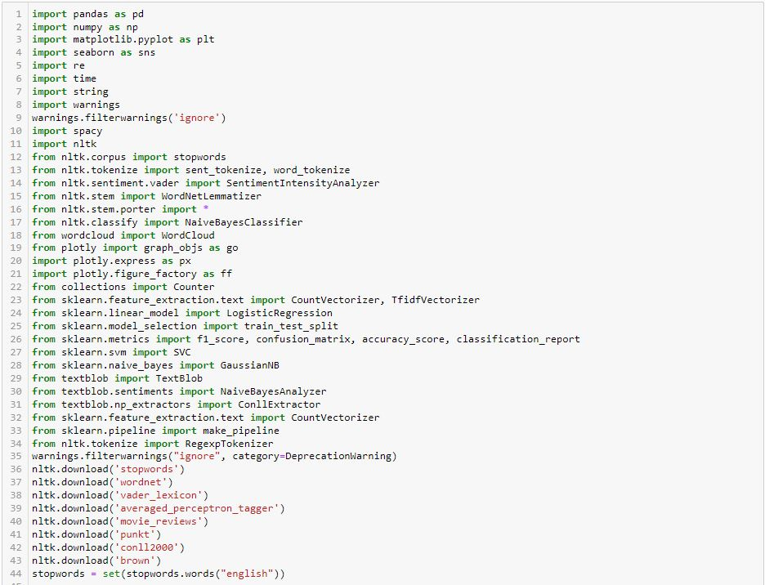

TEXTRACT
This packages provides a single interface for extracting content from any type of file, without any irrelevant markup.

Slide 6
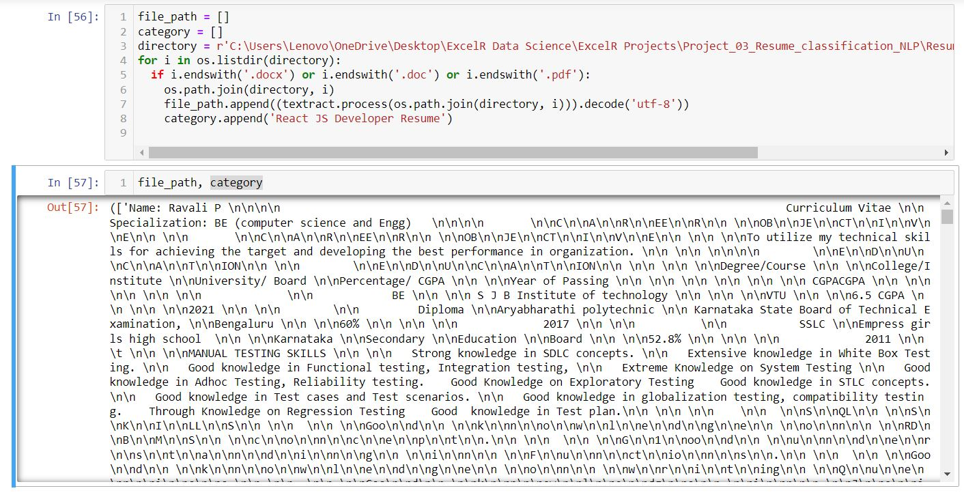
CONVERTING ALL FILES TO .TXT(PROCESS)

Slide 7
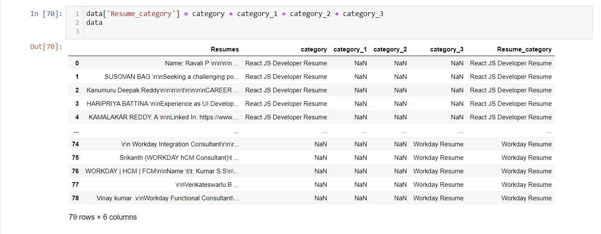
MERGING ALL CATEGORY FILES.

Slide 8
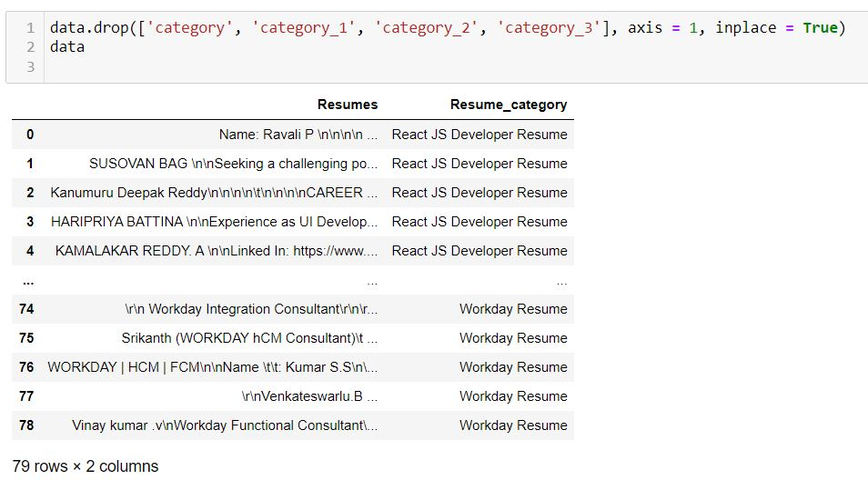

CONVERTING TEXT TO .CSV (PROCESS)

Slide 9
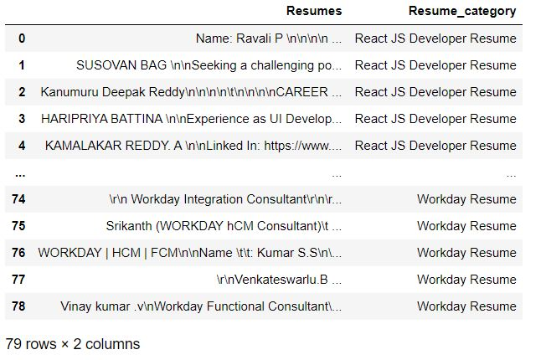
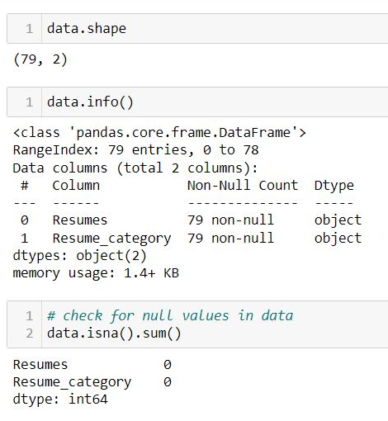
DATA SET DETAILS
After Extracting and Modifying the Dataset, given data contains a total of 4 classes and 79 rows & 2 columns.

Slide 10
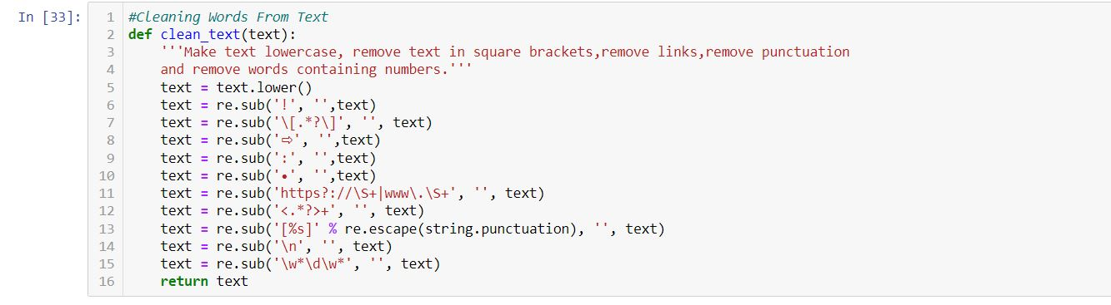
Removing all unwanted character’s
Unwanted Character’s like - \n \t, http links, tags, hashtags, html tags, converting to lower case, removing white spaces etc.
Word Tokenization - Tokenization is essentially splitting a phrase, sentence, paragraph, or an entire text document into smaller units, such as individual words or terms. Each of these smaller units are called tokens.
Removing Stop-words - A stop word is a commonly used word (such as “the”, “a”, “an”, “in”) that a search engine has been programmed to ignore, both when indexing entries for searching and when retrieving them as the result of a search query.

Slide 11
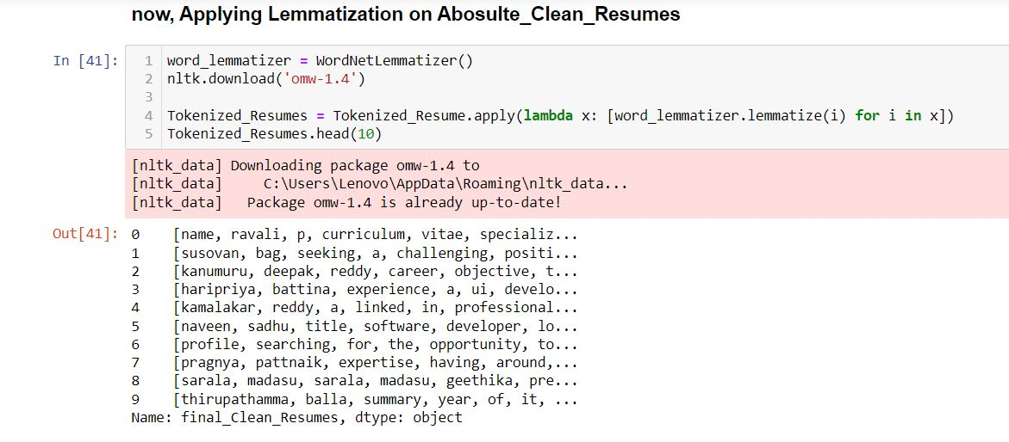
TEXT PREPROCESSING

Slide 12
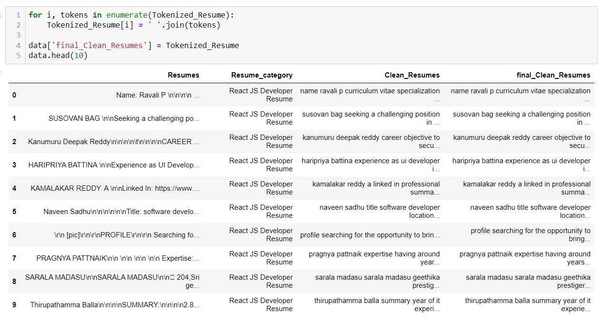

Slide 13
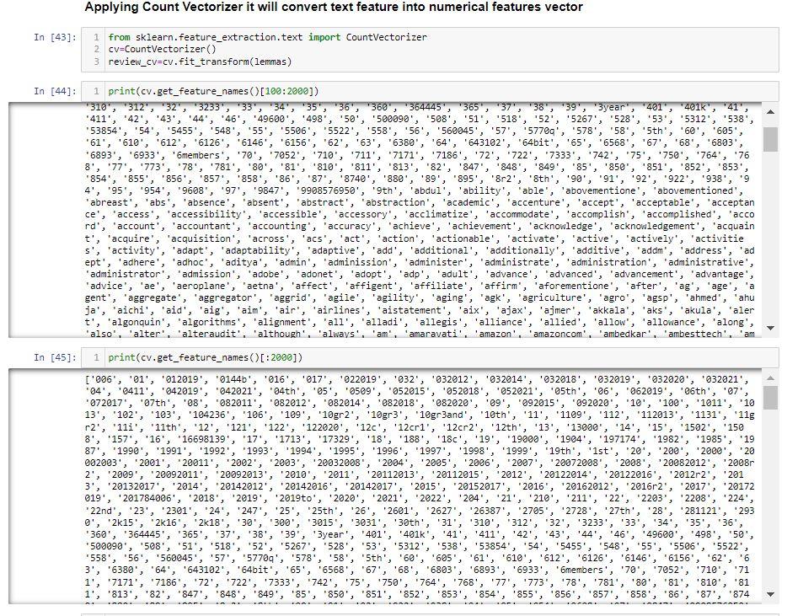

Slide 14
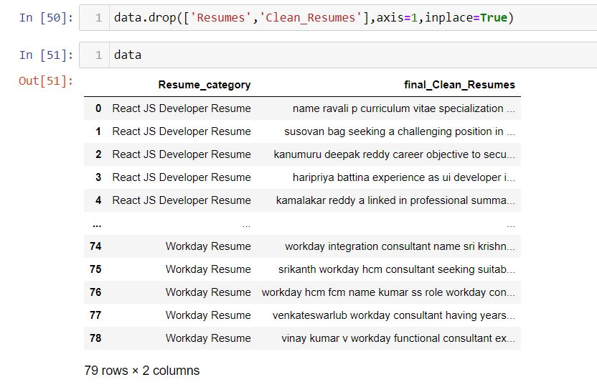
TEXT PREPROCESSING
In natural language processing, text preprocessing is the practice of cleaning and preparing text data. NLTK and re are common Python libraries used to handle many text preprocessing tasks.
The Dataset contains 79 rows and 2 Column.
There are total four Classes – Peoplesoft, Workday, React JS Developer and SQL Developer.

Slide 15
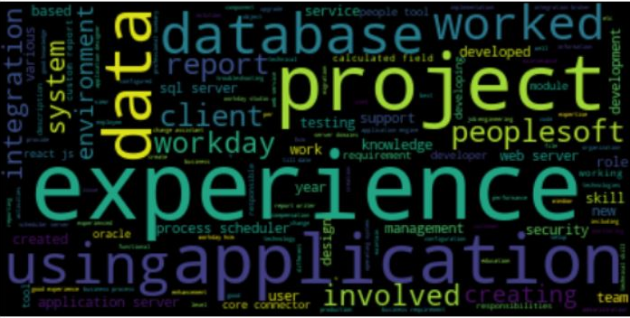
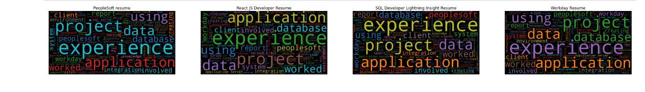
WORD CLOUD

Slide 16
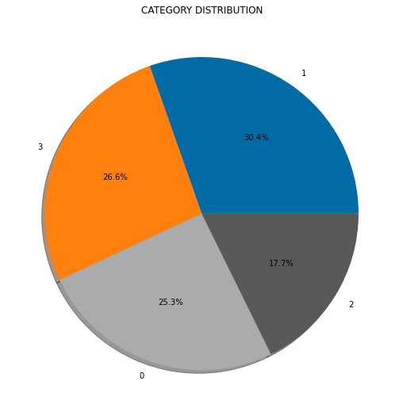
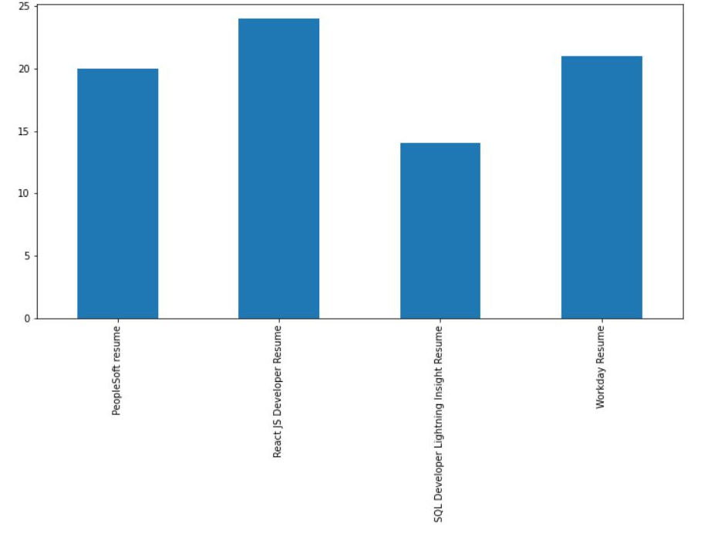
By using Pie chart roles applied feature is displayed to visualize the job roles.
By using Histogram roles applied feature is displayed to check the job types.

Slide 17
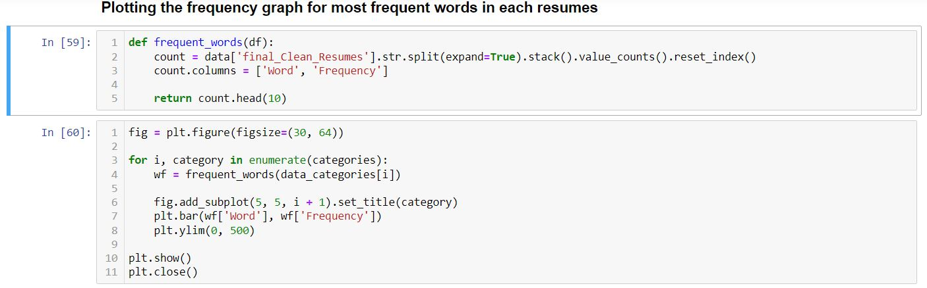
Most frequent words in each resumes

Slide 18
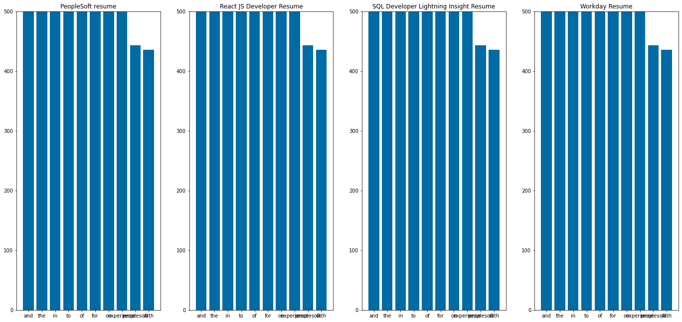

Slide 19
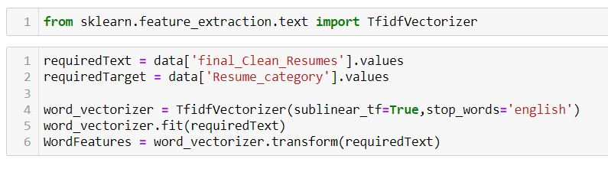
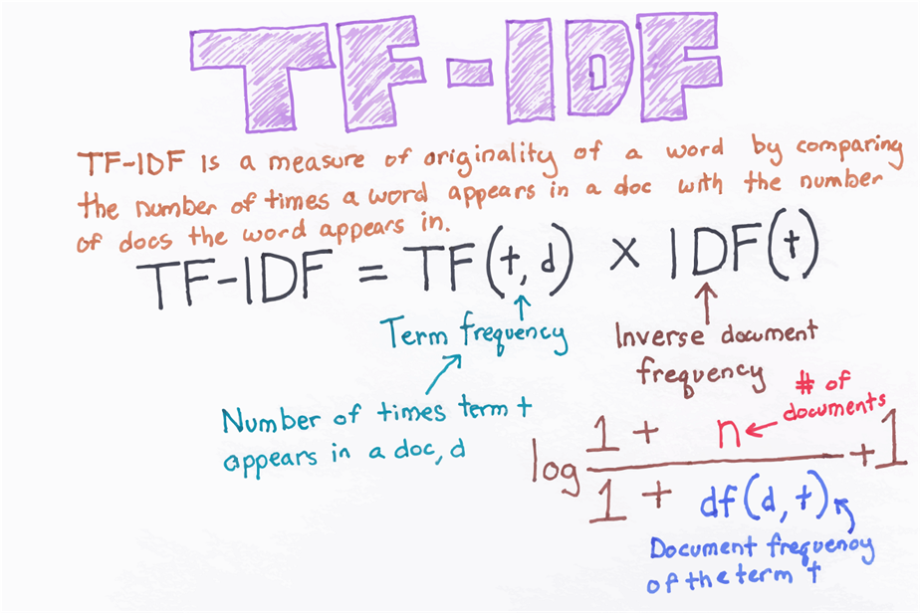
TF- IDF
TF-IDF is better than Count Vectorizers because it not only focuses on the frequency of words present in the corpus but also provides the importance of the words.
We can then remove the words that are less important for analysis, hence making the model building less complex by reducing the input dimensions.

Slide 20
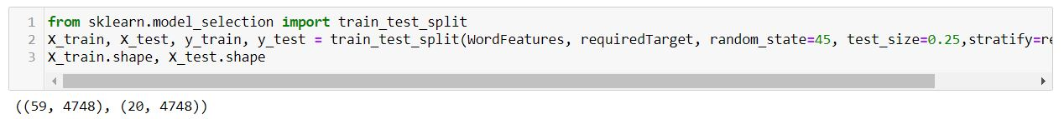
TRAIN - TEST SPLIT

Slide 21
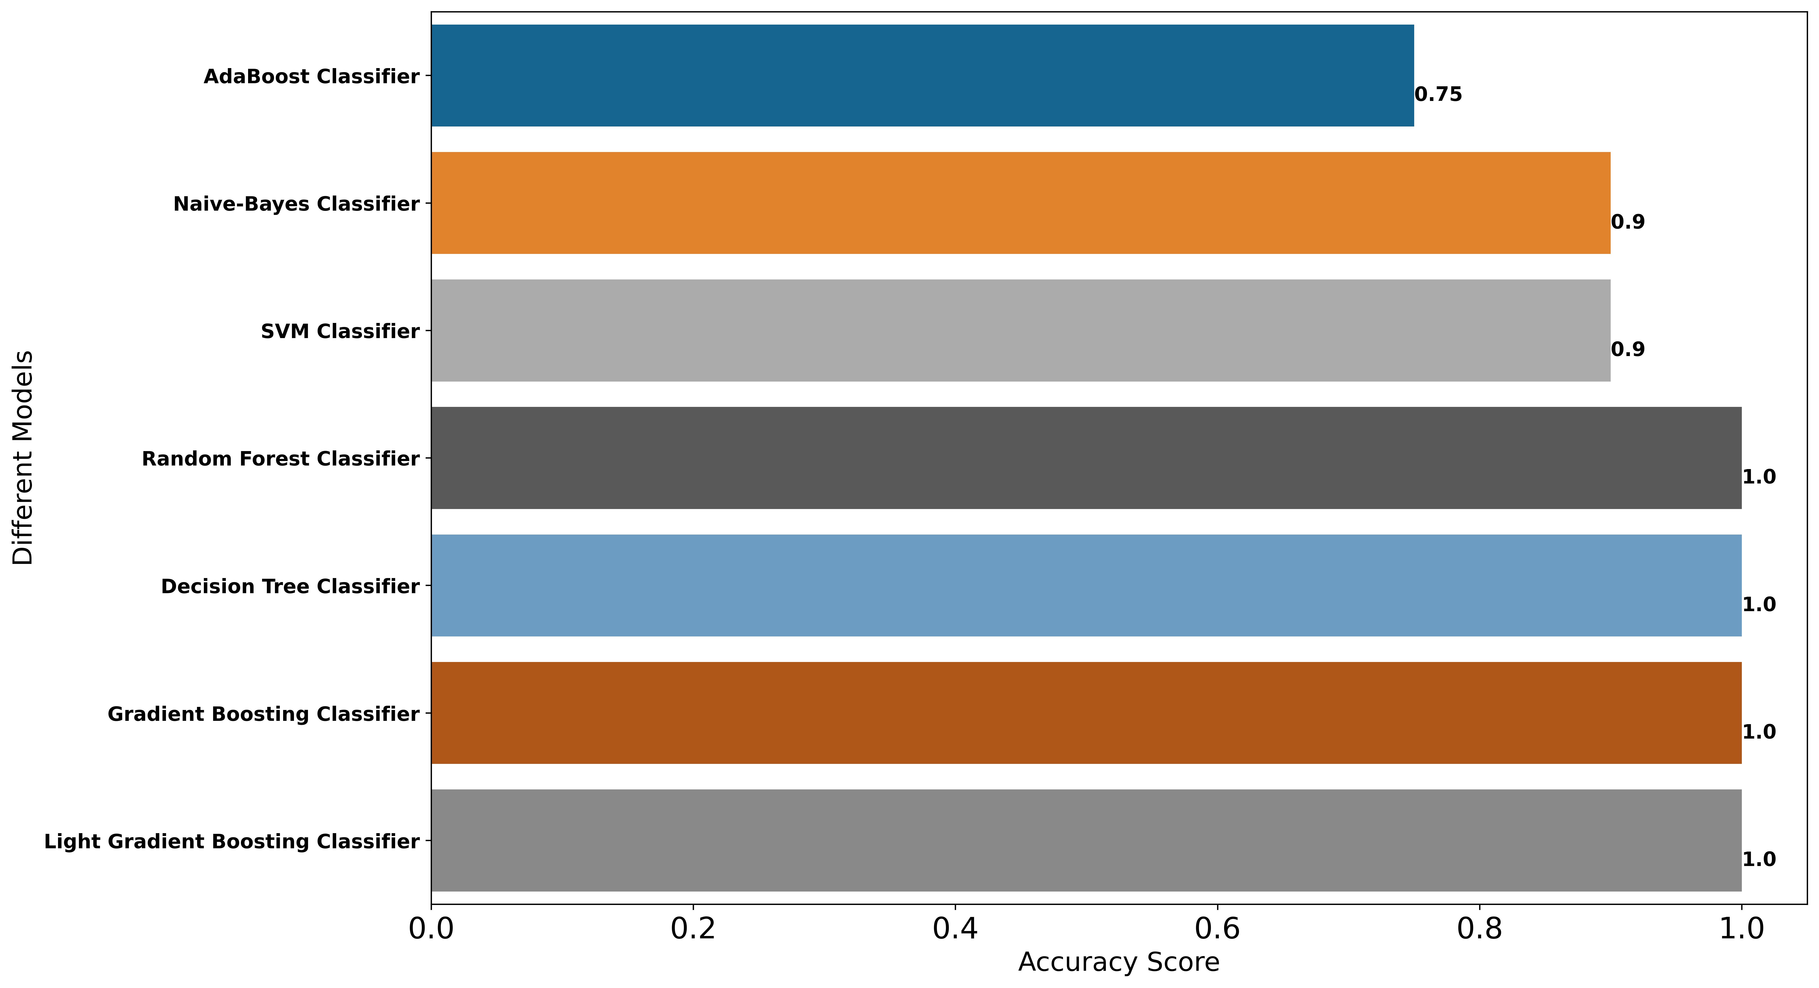
MODEL BUILDING

Slide 22
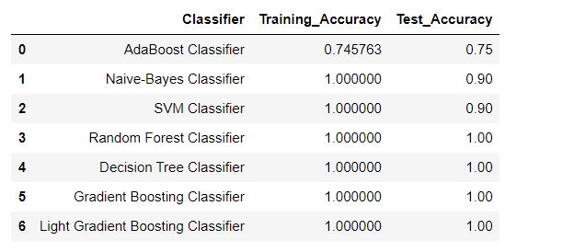
MODEL EVALUATION
Here, we have taken Model building algorithms such as Decision Tree Classifier, Ada boost classifier, SVM, Random , Forest, etc.

Slide 23
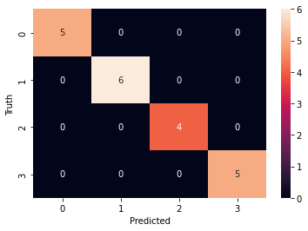
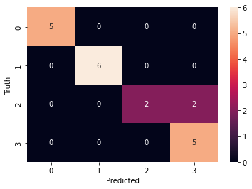
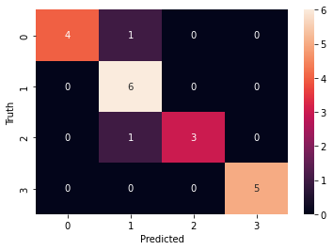
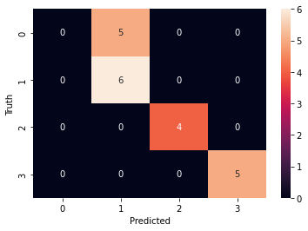
MODEL EVALUATION
Here, we have taken Model building algorithms such as Decision Tree Classifier, Ada boost classifier, SVM, Random , Forest, etc.
Random forest
Naive bayes
SVM
Among these algorithms, 100% Accuracy, have been achieved.
Decision Tree
Ada Boost
Gradient Boosting

Slide 24
100% accuracy is achieved by using the model Random Forest, Decision Tree, Gradient Boosting Classifier , Light Gradient Boosting Classifier.
Light Gradient Boosting Classifier.

Slide 25
Model Evaluation Report

Slide 26


